Slide 1
Introduction to Python
Mitch Schmidt

Slide 2
$ whoami
First year Master’s, Cyber Security major
BS in Comp Sci and Math from FSU
President of the Cybersecurity Club @ FSU
SFS Event Coordinator
Doing CTFs for >1 year
Main topics: Crypto, Reversing, Exploitation
Introduce yourself!

Slide 3
Demographics
How many are Computer Science(/Cyber Security)
How many have heard of CTFs?
How many are undergrads?
How many have used Python?

Slide 4
How to get good (at Cyber Security)
Start as soon as possible!
Learn the basics - learn about the different topics (Forensics, RE, Pwning, Crypto, Web) and the basics about each
Find an interest - you won’t get good at a subject unless you have an interest. Find one and stick with it, there will be difficult times and rewarding times
Hack as much as possible - find wargames, ctfs, or other websites that allow you to hack things. Make sure there are write-ups available!
Read technical news and papers - these will make sure you stay fresh on the basics and learn new techniques that are evolving today
Ask for help when you need it - at worst, two heads are better than one at solving a problem

Slide 5
Who should take this class
A student who loves challenges
A student who has heard of CTFs but is reluctant to go to one due to the high barrier of entry
A student who has been to a CTF but doesn’t know where or how to get started
A student who is experienced with CTFs but wants to learn the basics of other classes
A student who has never heard of CTFs but wants to learn Cyber Security to get a great job and lots of money
You can learn the basics from classes (only to a couple topics if it wasn’t for Dr. Liu), to be really good, you have to struggle and learn extracurricularly
Note - no skill requirements, we don’t expect you to be a ninja already

Slide 6
Who shouldn’t take this class
A student who wants to be a programmer/software engineer
A student with a ton of extracurriculars that is never going to take a Cybersec class again
A student who will look up the answer to a question 5 minutes after trying to solve it
Ninjas
I wouldn’t necessarily call any of these bad, but not everyone fits this description
Talk to me if unsure!

Slide 7
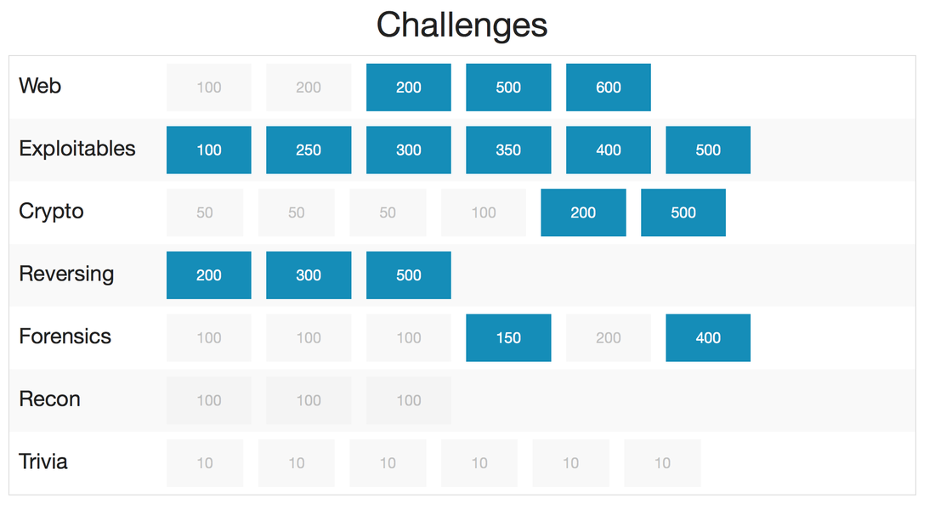

Slide 8
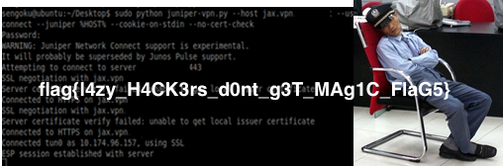
What is a CTF?
Questions - https://www.google.com/search?q=csaw+ctf&source=lnms&tbm=isch&sa=X&ved=0ahUKEwj5uOz3pLTRAhUr3IMKHa-IDVEQ_AUICygE&biw=1728&bih=1003#tbm=isch&q=ctf+question&imgrc=I5VIevG5wQtaXM%3A
Answers - something like (CSAW 2016, “Sleeping Guard”)

Slide 9
What is Python?
The most popular scripting language for general-purpose applications
Interactive, dynamically-typed language
Easy to use, learn, and read
Similar syntax to C/C++ which we spend a long time learning here at FSU

Slide 10
Why do we use Python?
Fast to write - just open a text editor, write a program, run “$ python myprogram.py”, especially network programming
Popular - most of the CTF community uses python, you’ll notice it when you read write-ups
Extensible - A bunch of libraries online to help with different topics (pwntools, gmpy) - I am currently working on a crypto library with a bunch of common functions you’d use
Portable - Can easily switch same code between Linux and Windows
There is a time and place for languages like C/C++, and CTFs are not that

Slide 11
In this class
Feel free to use other languages - but keep in mind that if you use C/C++ or Java you are putting yourself at a significant disadvantage
As you would need to write much longer programs using C/C++/Java compared to Python

Slide 12
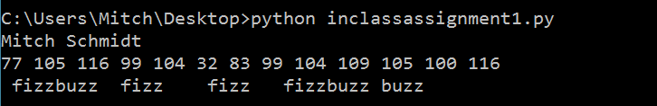
In-Class Assignment 1
Fizzbuzz on each of the ascii values of the characters in your first name + last name
Print your first name, last name, then the ascii values of each. For each value in this list, print “fizz” if divisible by 3, “buzz” if divisible by 5, and “fizzbuzz” if divisible by both

Slide 13
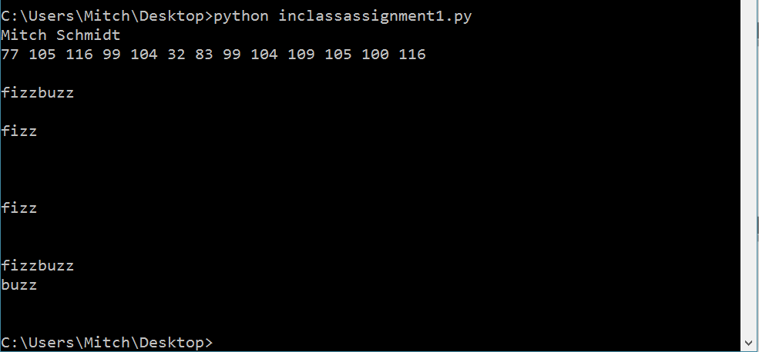
In-Class Assignment 2 Example

Slide 14
How to install
Linux - already there (need access to a Linux box for CTFs)
Windows - https://www.python.org/downloads/windows/ and have to add it to your path
Mac - already there
From next class on, you’ll need a Linux VM (Ask if you need help!)

Slide 15
Learn Python interactively
https://www.learnpython.org

Slide 16
Check out the Docs
https://www.python.org/
Google
Download packages with “$ pip install $package”

Slide 17
In class Assignments
Feel free to leave/help others/chat with me if you complete these
Feel free to ask me for help or work on it in a small group

Slide 18
Assignment 2
Use the file here as a dictionary: https://github.com/dwyl/english-words/blob/master/words.txt
Count how many words in the dictionary contain any consecutive 3-letter sequence in your firstname+lastname (for me, any word containing one of “mit”, “itc”, “tch”, “chs”, “hsc”, … , “idt”; the consecutive 3-letter sequences of “mitchschmidt”) - the result should be an integer
Do it in less than 3 lines to impress me ;)

